Slide 1



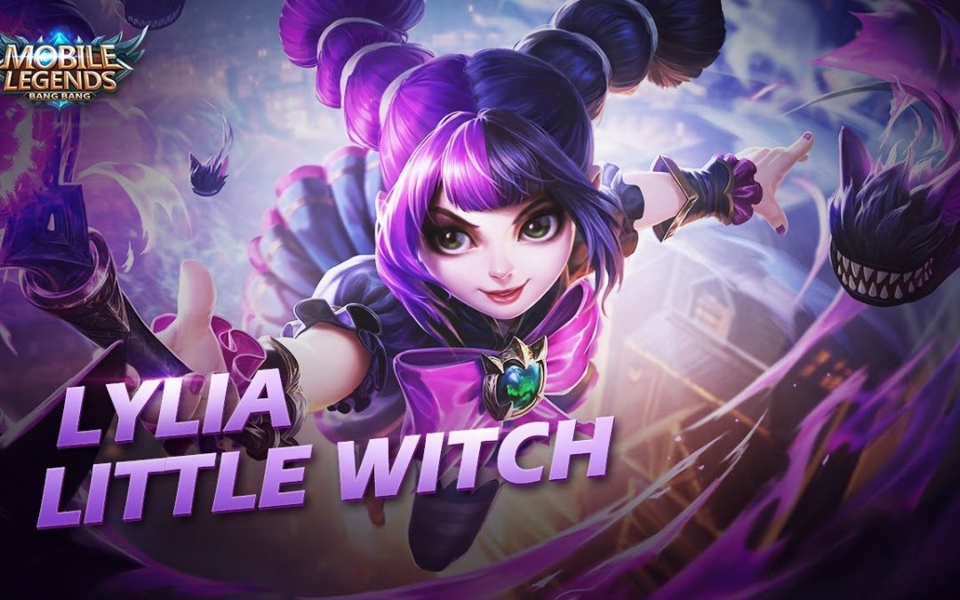
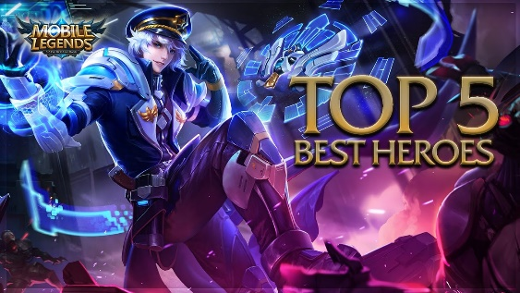

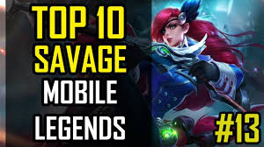

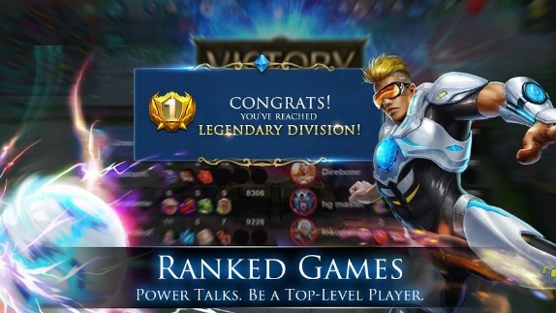

IOS | Download
Android | Download
LOGIN
News
What’s Hot
HOME
E-SPORTS
VIDEOS
All new hero Lylia the Little Witch, makes her MLBB debut! Get this little troublemaker and make short work of your enemies with the help of her deadly dark magic and dark companions!
Learn More
REWARDS
More

Slide 2


Username
Password
Remember Me
Forgot Password?
Login
Don’t have an account yet? Register Here

Slide 3




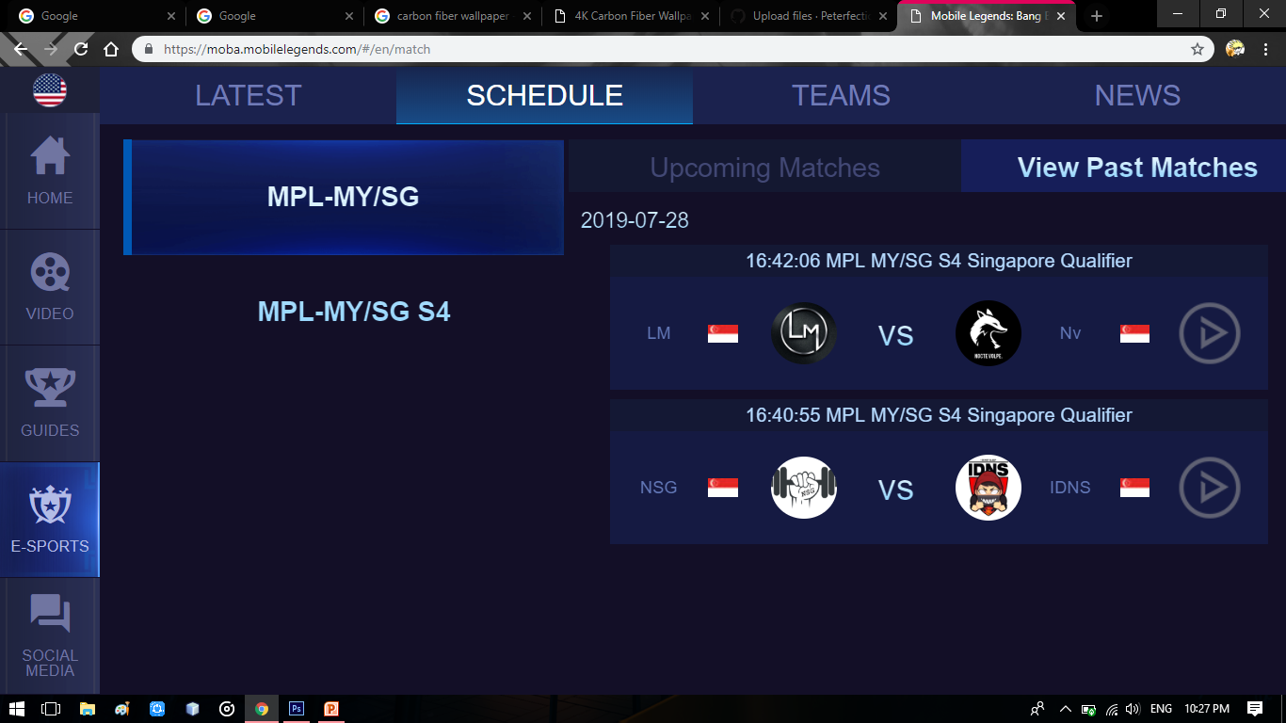
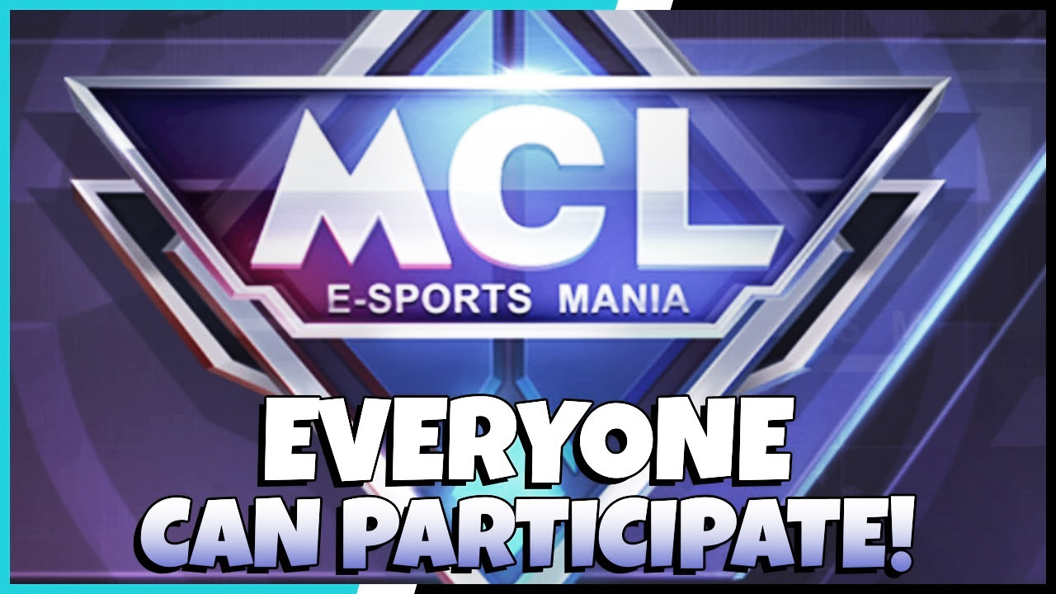
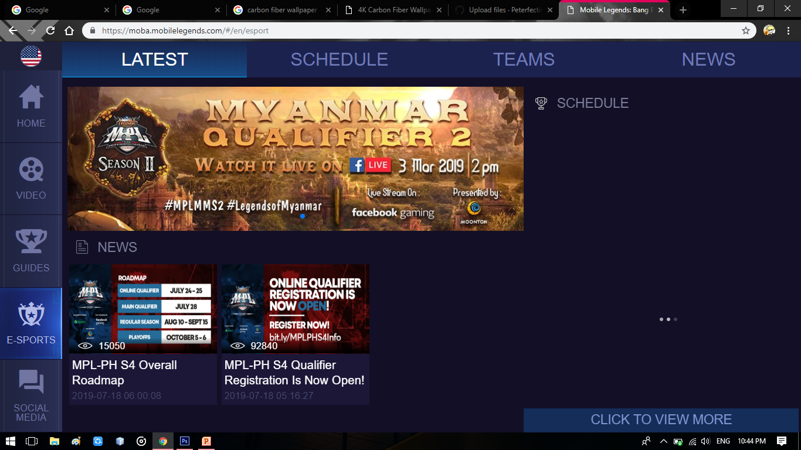
E-SPORTS
UPCOMING MATCHES
More Matches
Everyone can now participate in the E-Sports of MLBB! Try to win the weekly Championship to be able to enter the ultimate prize, the Seasonal Championship and win many rewards like a personal emblem, a beautiful skin chest and many more!
Learn More

Slide 4

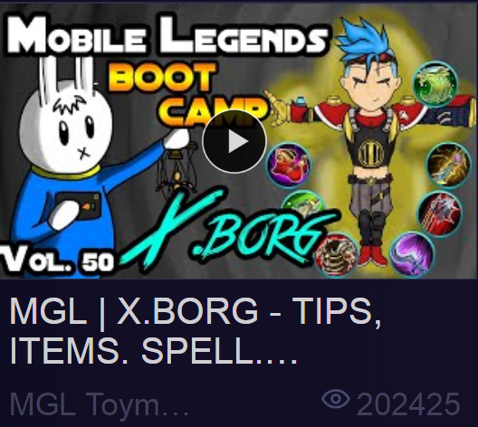
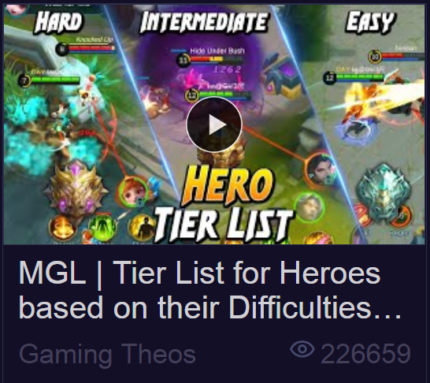

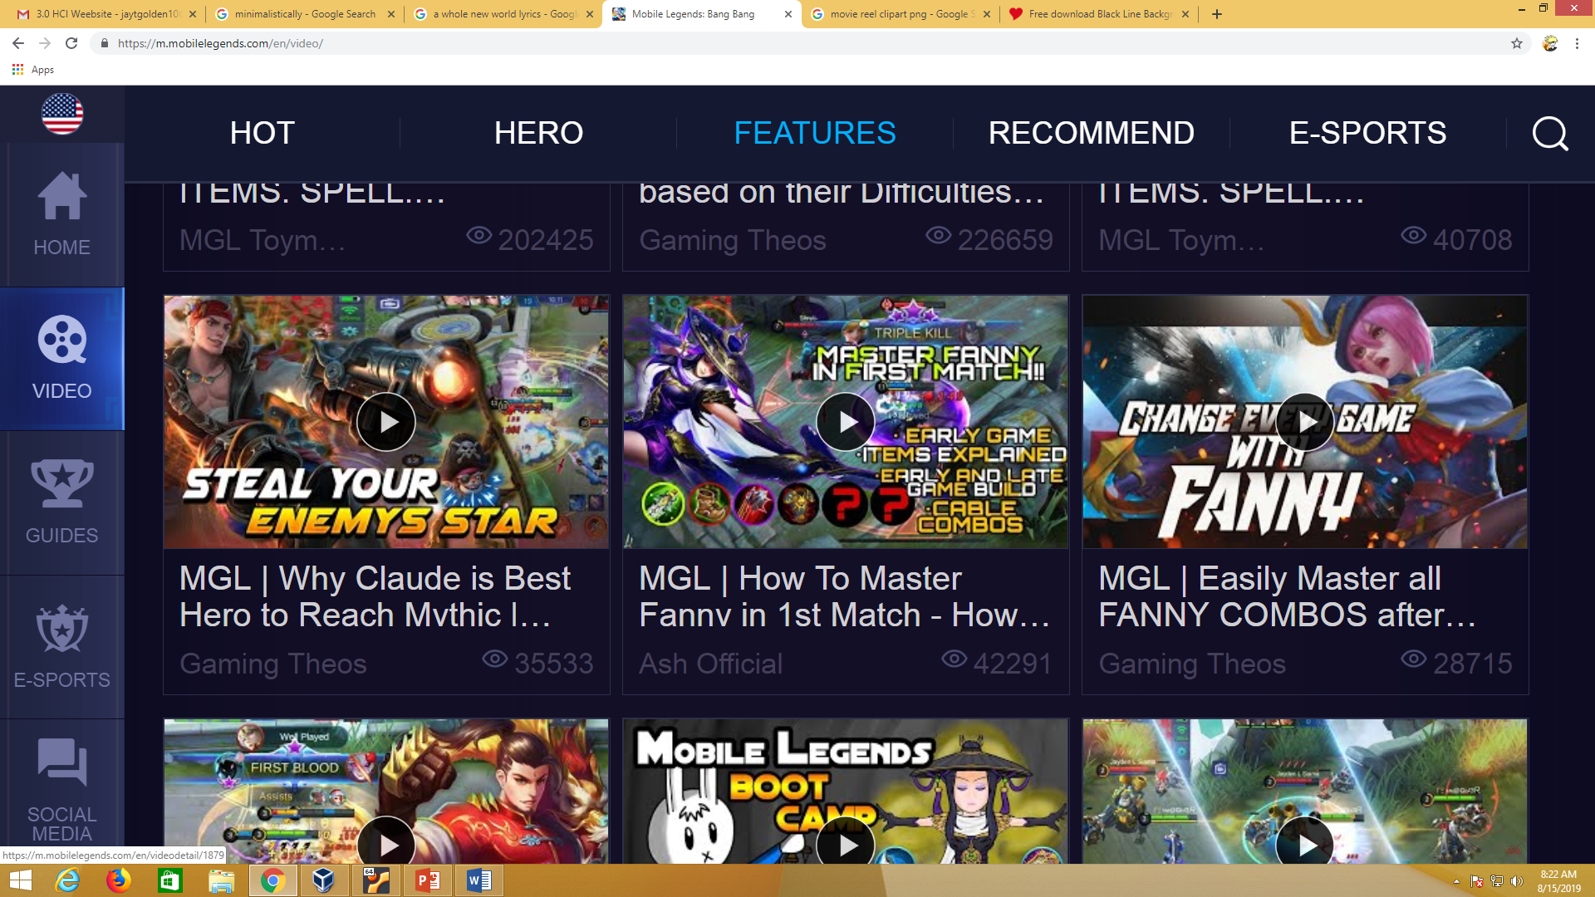
HOT
FEATURED
HERO
FEATURES
E-SPORTS
SHOW MORE

